Slide 1

Open Science NL The Dutch policy in practice
Ingeborg Meijer PhD
Ministry Education Culture & Science
CWTS, Leiden University
24 September 2025

Slide 2
Overview
The Open Science NL program – the policy perspective
The rationales of the Open Science program – the practice

Slide 3
The policy

Slide 4
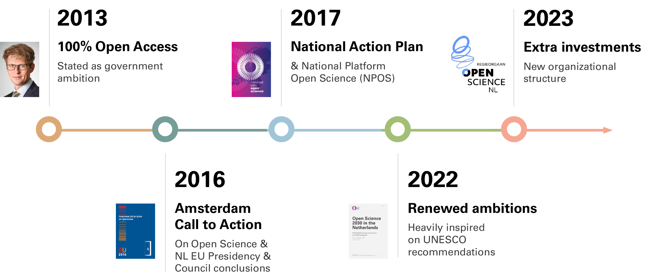
More than 10 years of support for Open Science in the NL’s
Notes:
Turning our attention to the Netherlands. Obvious that in the NLs OS is high on the agenda for quite some time. This timeline shows some of the milestones.
2023 former minister of OCW announced substantial investments leading to the launch of the “regieorgaan Open Science NL”

Slide 5
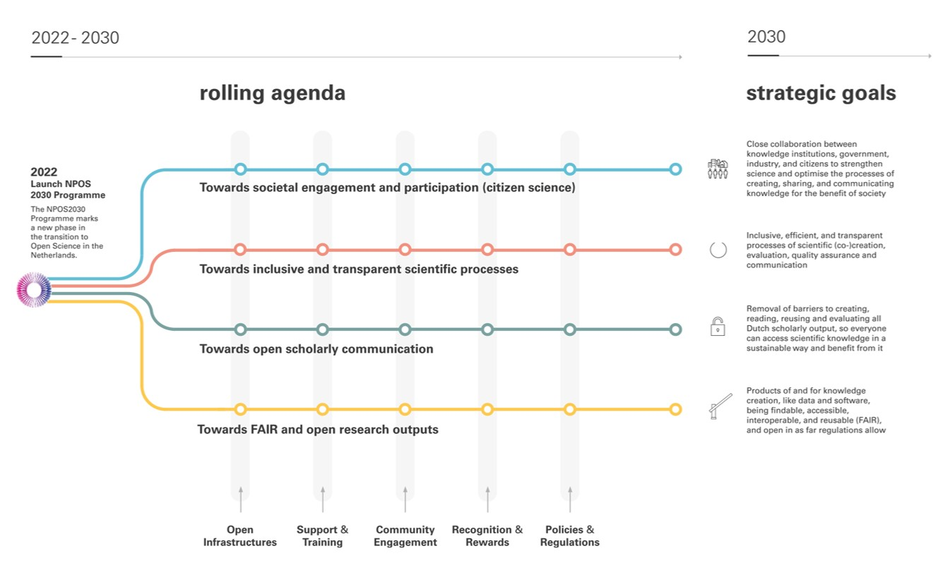
NPOS Rolling Agenda

Slide 6








Policy brief minister of education 17 June 2022
3.3 Kennis delen en benutten
3.3.1 Open science en open education open science en open education moeten de norm worden in hoger onderwijs en onderzoek, zoals het Coalitieakkoord stelt. Academisch werk moet vrij toegankelijk en gemakkelijk benaderbaar zijn en de dialoog tussen onderzoekers, docenten en burgers moet worden gestimuleerd. Vrije en veilige uitwisseling van ideeën tussen onderzoekers en maatschappelijke partijen is namelijk essentieel voor excellente wetenschapsbeoefening en draagt bij aan betere kwaliteit van wetenschappelijke kennis. Deze doelstellingen komen samen in de transities naar open science en open education, die zich momenteel nog in verschillende stadia bevinden. Om de transitie naar open science, die in het afgelopen decennium al is ingezet, extra kracht bij te zetten, verken ik met NWO de oprichting van een ‘Regieorgaan open science’, waarbij ik uiteraard ook in gesprek ga met het veld. Met dit orgaan kunnen inspanningen op nationaal niveau beter afgestemd, gebundeld en gecoördineerd worden. Het orgaan krijgt het beheer over € 20 miljoen per jaar om een impuls te geven aan de transitie, voor de looptijd van het Fonds voor Onderzoek en Wetenschap. Daarna moet open science de norm zijn en moet het volledig zijn opgenomen in de werkwijze van universiteiten en andere kennisinstellingen.
Open science and open education should be the norm in higher education and research.
To add further momentum to the transition to open science, which has already begun in the past decade, I am exploring with NWO the establishment of a 'Regieorgaan open science’.
The Regieorgaan will manage €20 million a year to boost the transition, for 10 years.

Slide 7






Mission of Open Science NL
To advance and accelerate open science in the Netherlands with the goal of making open science the norm
By providing (temporary) funding for projects, initiatives and infrastructures, along the lines of the NPOS agenda
By monitoring and evaluating progress
By providing a forum for exchange of best practice
By organising and facilitating coordination at a national level
7

Slide 8
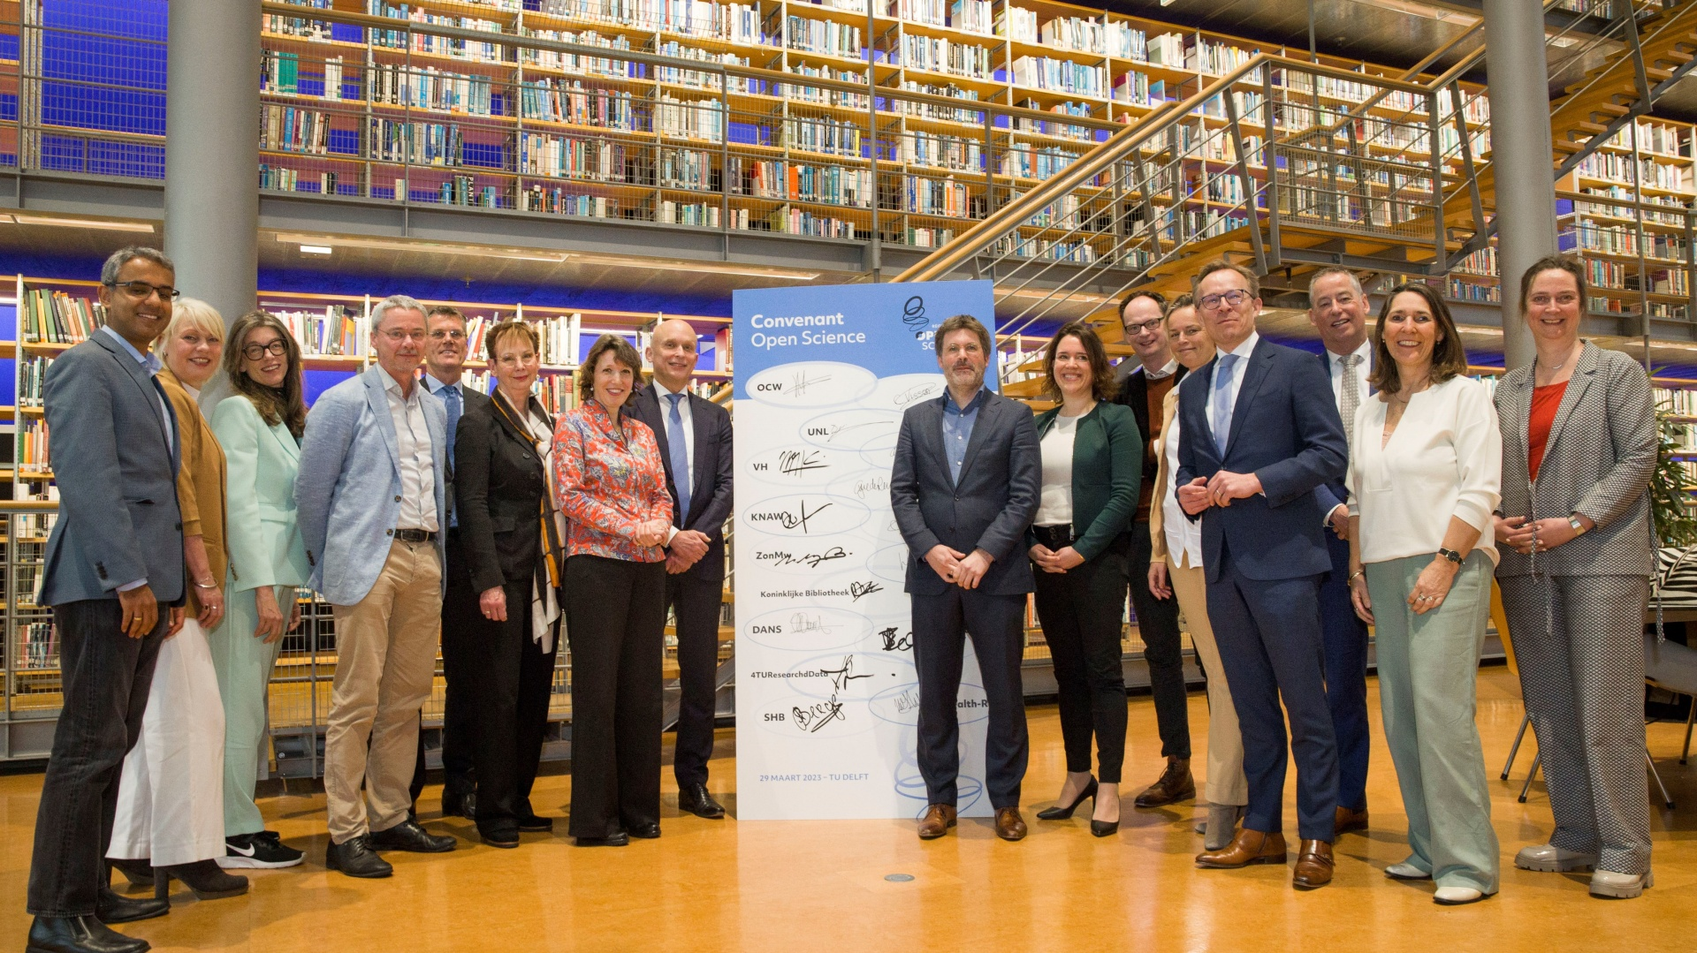
Signing Open Science NL covenant 29 March 2023
Ministry of OCW
NWO
UNL
NFU
SHB
VH
SURF
KNAW
NWO-I
ZonMw
UKB
National library of the Netherlands – KB
DANS
Netherlands eScience Center
4TUResearchData
Health-RI

Slide 9
Governance Open Science NL
Ministry of OCW
RvB NWO
Steering Board (6 members plus independent chair)
Open scholarly communication
Administrative consultation (national level)
FAIR data
Office (10 fte)
Open research software
Citizen science and societal engagement

Slide 10
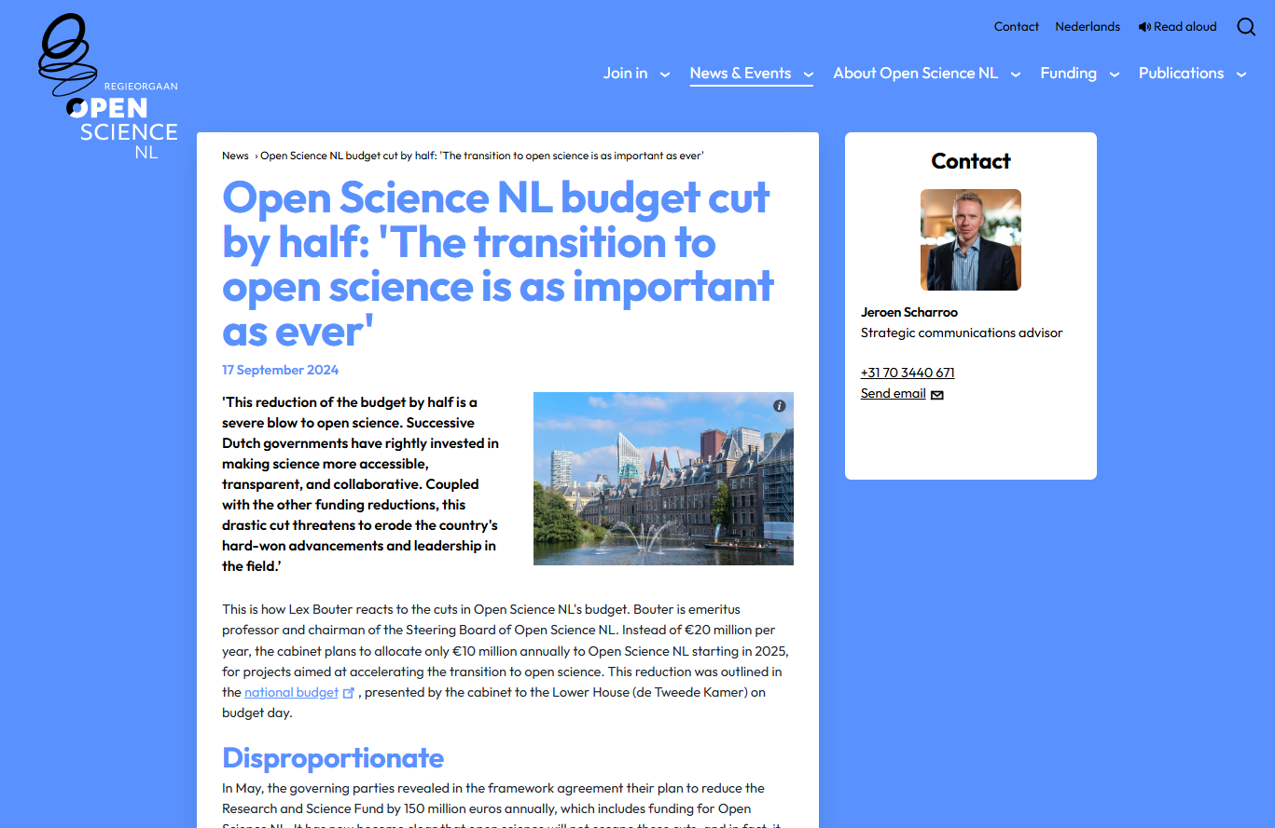

Slide 11
The practice of Open Science NL

Slide 12



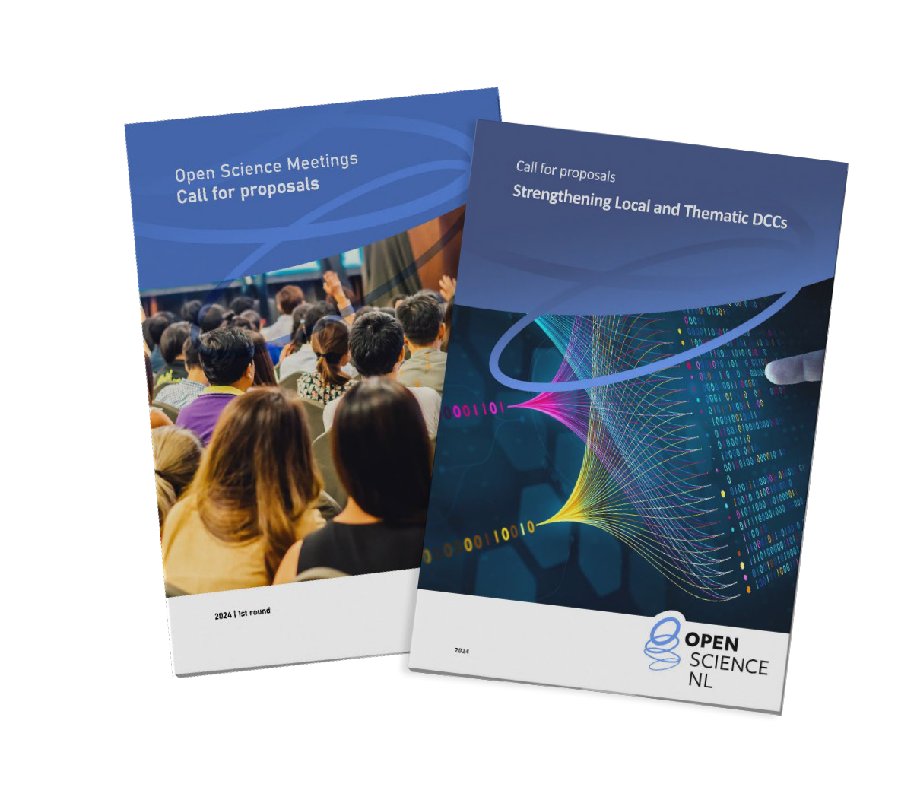


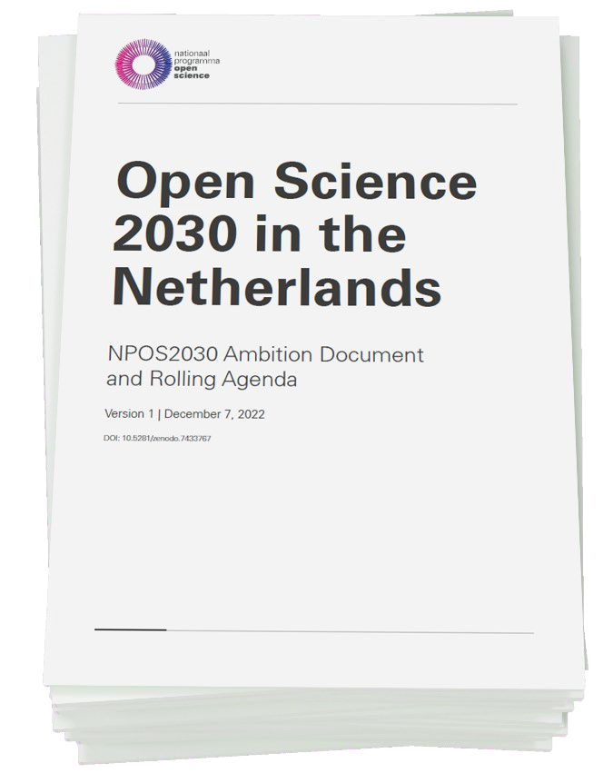
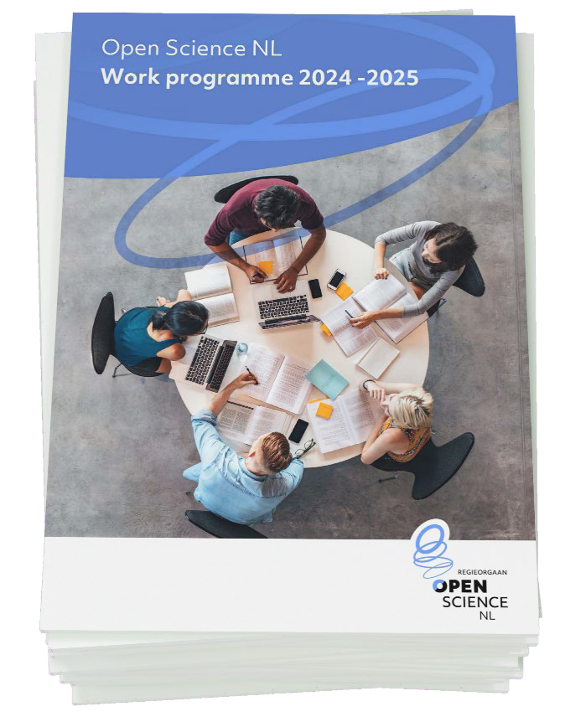


How Open Science NL works
National Ambition Document provides overal framework
Work programme (every 2 years) based on community consultation, to be approved by SB
A diverse set of instruments (calls, tenders, targeted grants)

Slide 13
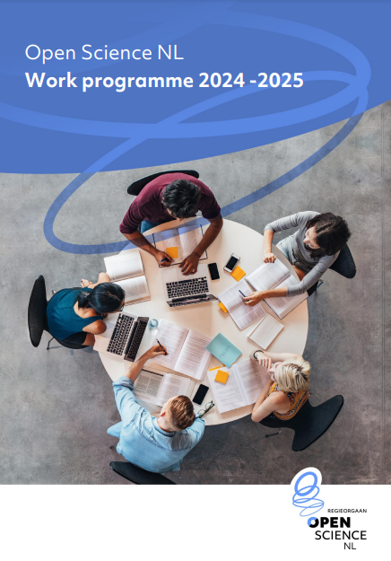





Structure of the first work programme
Capacity building for Open Science - € 22,4m
Infrastructure for Open Science - € 17,5m
Transparant Research processes - € 11,2m
Evidence base for Open Science- € 3,3,m
Empowering communities - € 4,5,m
15 funding “actions”
Of varying sizes
Covering all aspects
of the Open Science agenda
Open scholarly
communication
FAIR
data
Open Research
Software
Citizen Science
Societal Engagement
Notes:
How are we spending this money?

Slide 14

Programme overview
Capacity building
Infrastructure
Robust research processes
Evidence base for open science
Empowering communities
1.1
Training and community for data professionals
2.1
Open science infrastructure programme
3.1
Replication studies
4.1
Research on open science
5.1
OS Festival
4.2
Participatory citizen science calls
5.2
OS meetings
3.2
Software sustainability
1.2
Strengthening DCCs
5.3
OS Communities
4.3
Monitoring and evaluation
5.4
CSNL
1.3
Citizen Science Hubs
5.5
Recognising and Rewarding open science
1.4
Enabling Open publishing
14

Slide 15
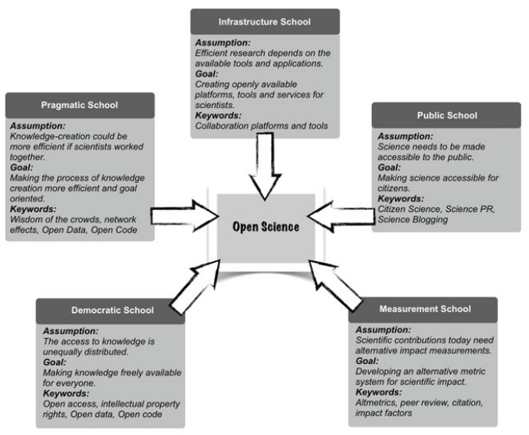
One term, five schools of thought
Infrastructure School
Pragmatic School
Public School
Democratic School
Measurement School
Fecher & Friesike, “Open Science: One Term, Five Schools of Thought” (2013)
Notes:
There is many reasons to make scientific results openly available. There is not *one* reason. And there are many people working in this area but many with slightly different agenda’s. That is not a problem.
Some are precoccupied by making science open to the public. Others with making science more transparant and trustworthy. Others with ensuring that the ways research is being asseses gets reformed because they are concernced that current assessement practices leads science away from its role to find solutions for pressing societal issues.
Open science is a broad church. All these agenda’s are equally valid.

Slide 16
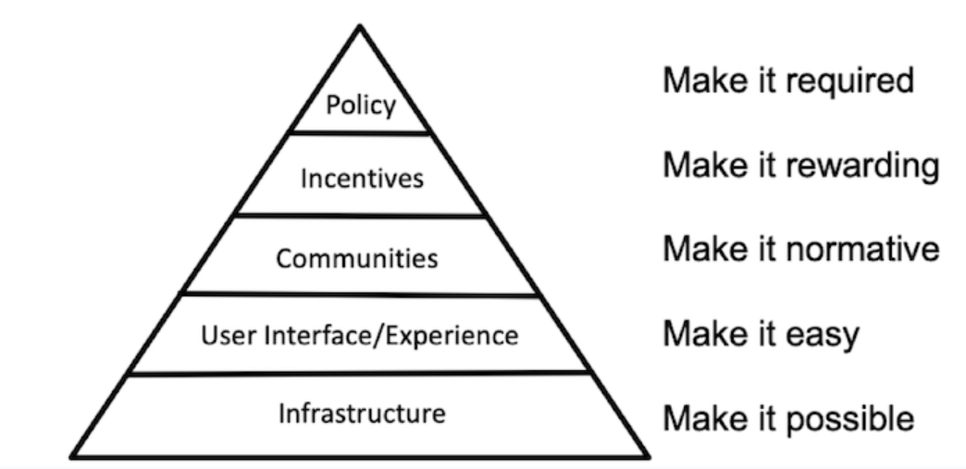
Open Science: a culture change
Brian Nosek, “Strategy for Culture Change” (2019)
Notes:
Open Science is a cultural change. To explain, Brian Nosek, proposed this pyramid. Main message: transition to open science cannot be left to the enthousiams of individual researchers. It requires action on multiple levels at the same time.

Slide 17

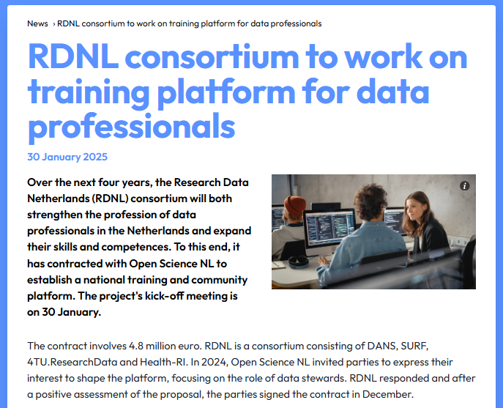
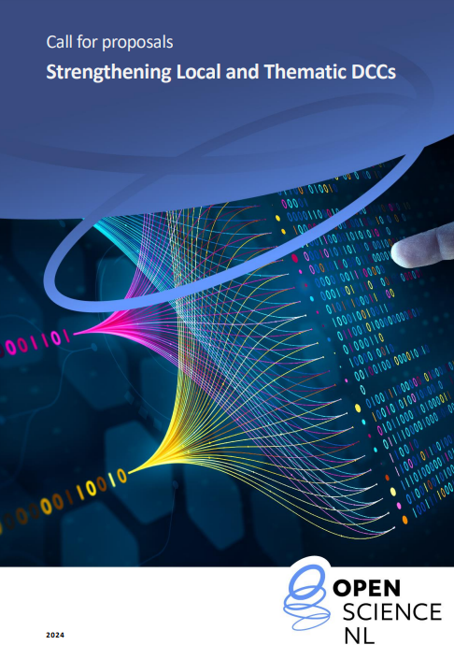

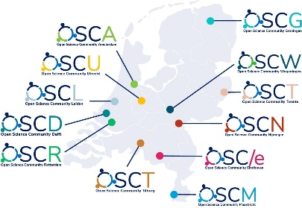



Slide 18
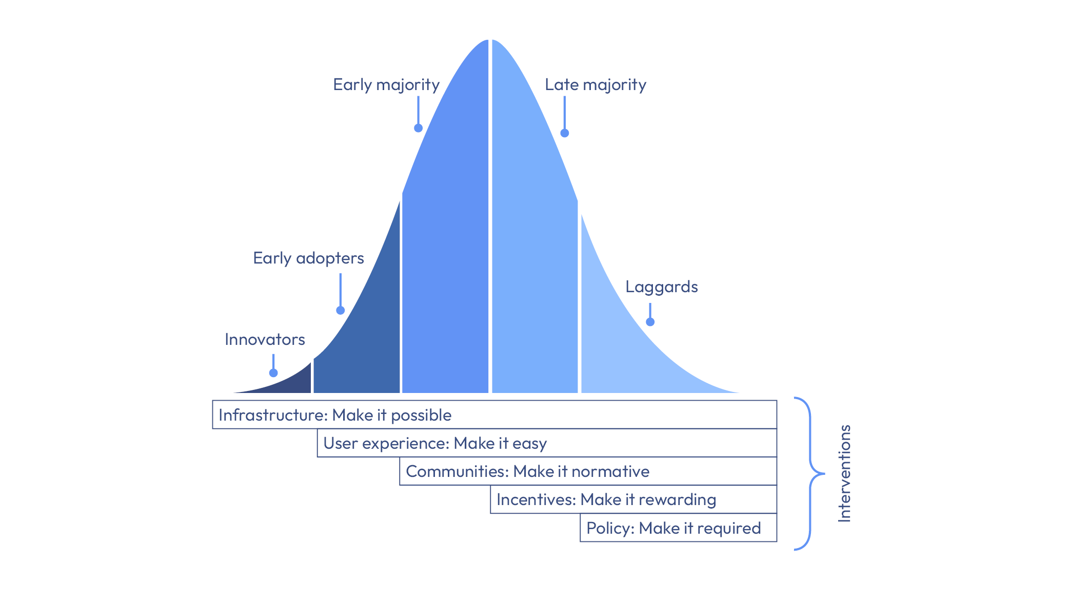
Credit for the figure: Brian Nosek, Everett Rogers, Anita Eerland, Alicia Dekker

Slide 19
A culture of sharing
(which is recognized
& rewarded)
Transparancy, reproducability,
RDM, open peer review
Open Science (OS)
(sharing research openly)
Research
Integrity (RI)
(accoding to the highest norms)
Replication studies, preregistration, negative results (and the R&R for that)
Bibliodiversiteit, Multilingualism, Diamond open access
Recognition & rewards (R&R) / DORA
(responsible research assment)
Healthy
research
culture
Datastewardship, R&R of “support staff”
Team science Responsible metrics,
Leiden Manifesto
Equity, diversity, inclusion (EDI)
(fair chances for everyone)
An inclusive research culture, where we prevent systematic biases
A safe research cutlure. Zero tolerance towards academic bullying, #metoo, etc.

Slide 20
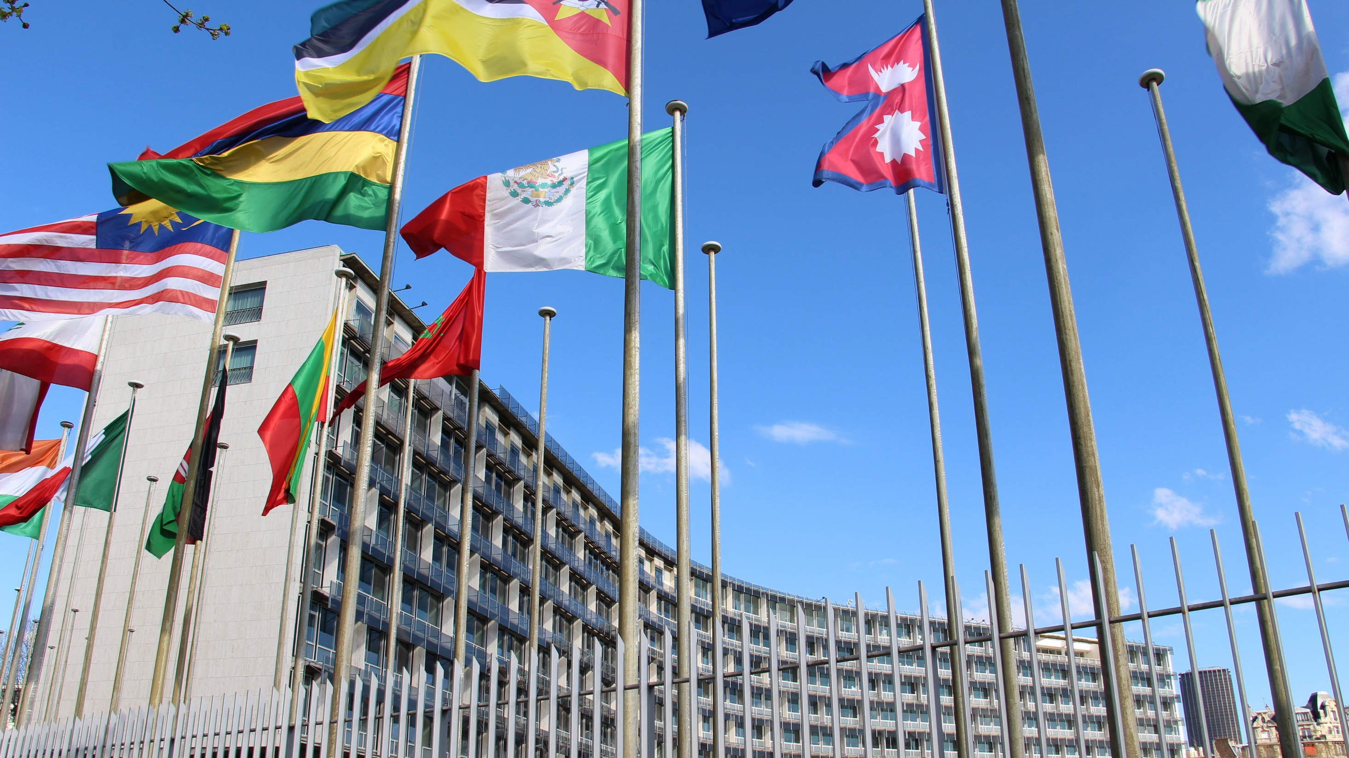
What is open science?
“Open science is a set of principles and practices that aim to make scientific research from all fields accessible to everyone for the benefits of scientists and society as a whole.
Open science is about making sure not only that scientific knowledge is accessible but also that the production of that knowledge itself is inclusive, equitable and sustainable.”
UNESCO Recommendation on open science, 2021

Slide 21
Some recent trends and developments
The US
Equity
Knowledge security
Generative AI

Slide 22
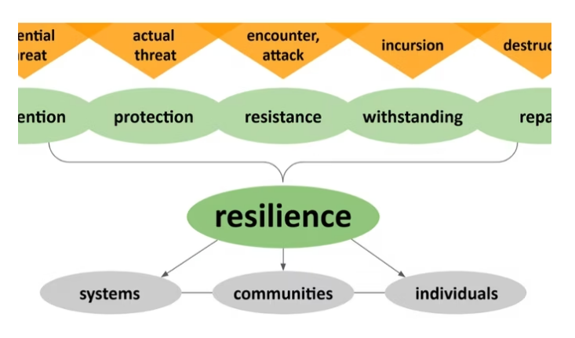
The resilience of open science in times of crisis
Threats
funding,
research infrastructure,
academic freedom,
safety of members of the academic community and
disinformation and science scepticism.

Slide 23

Thank you for your attention
i.meijer@minocw.ml
i.meijer@cwts.leidenuniv.nl

